Slide 1
Indoor Drone Research and Development Project
Group 9

Slide 2
TABLE OF CONTENTS
OUR TEAM & CLIENT
01
04
Sneak Peek
02
05
Major Requirements
Project Stages
03
06
Project Goals
Our Team
Here you could describe
the topic of the section
Here you could describe
the topic of the section
Here you could describe
the topic of the section
Here you could describe
the topic of the section
Here you could describe
the topic of the section
Here you could describe
the topic of the section

Slide 3
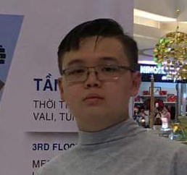



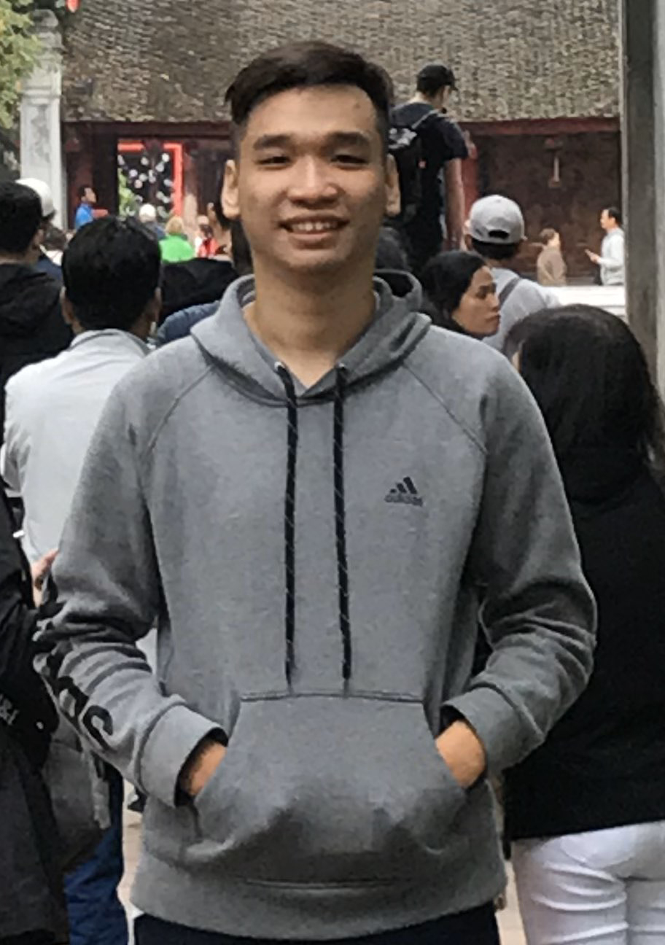
OUR TEAM
TRAN DUC HUY
TRAN HUNG THINH
LE NGUYEN HAN HOAN
DO THIEN Y
NGUYEN MINH QUAN
Project Leader
Developer
Computer Vision
Developer
Business Analyst
Business Analyst, Data Labelling and analytics
Communication, problem solving,
C++, Arduino, Scratch,
electronic fundamental
C++, Python, OpenGL, Machine learning, Data Labelling and analytics
Arduino, Scratch, designing,
electronic fundamental, C++
C++, Communication, problem solving,
Documentation, Business Analyst
Supervised by: Mr. Cao Xuan Nam

Slide 4

OUR CLIENT
Client: Fromlabs Solution LTD
Presented By: Mr.Petteri Kaspenpalo and Mr. Hieu
Address: 8 Burn Road Singapore 369977
Phone: SG (+65) 9235.4689, US (+1) 917.410.0388
Email: info@fromlabs.com

Slide 5
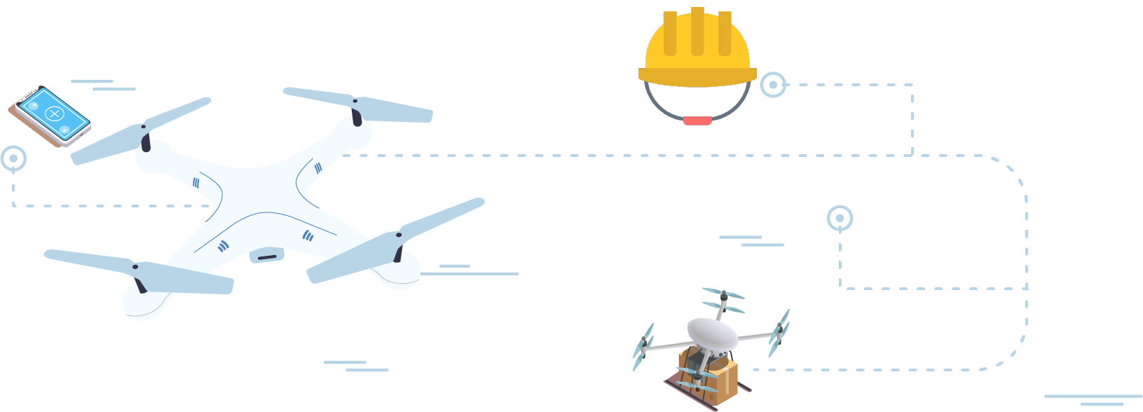
ABOUT THE PROJECT
We’re aiming to introduce drones to assist in tasks automatically without human intervention.
We will be able to introduce a new potential IoT aspect.

Slide 6


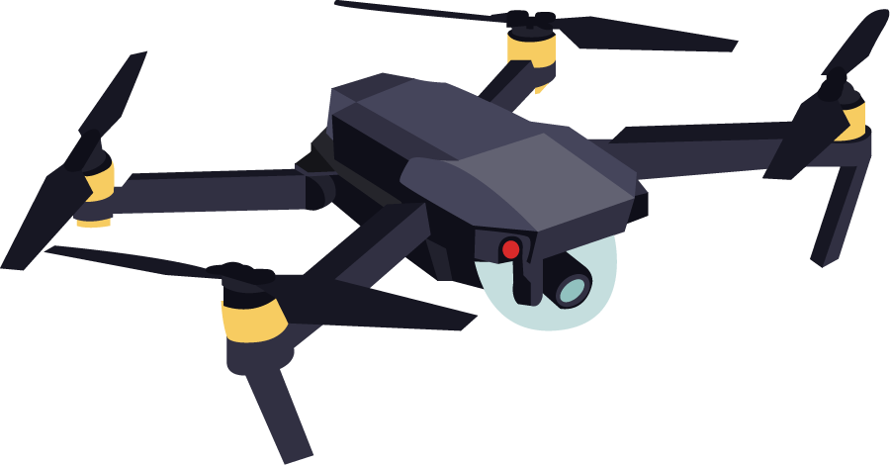

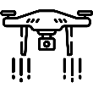


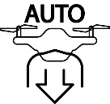

OUR VISION
SIMPLE MOVEMENT
SELF-BALANCE
AVOID OBSTACLE
NAVIGATION
BIG CONNECTION RANGE
OPERATING TIME
AUTO LANDING
SELF OPERATING

Slide 7






OUR VISION
REQUIREMENT ANALYSIS
DESIGN
IMPLEMENTATION
TESTING
MAINTENENCE

Slide 8

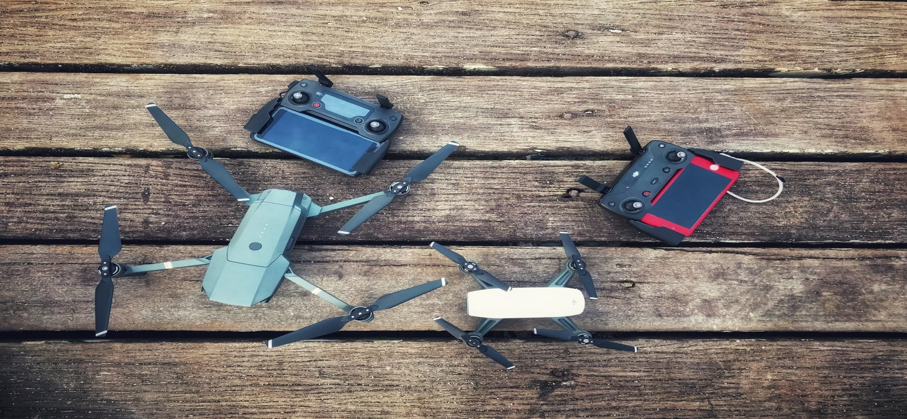
Project Deliverables
01
Project goals
Fully functional drone
Semi-Automated drone control software
A functional drone
Project documents
02
Modular development and architect plans of the project
Project Objectives
Drone prototype for demonstration purposes
Basic movement
Automated fly without human intervention
Object/Facial recognition
Ground Control Application
Test-cases performed on the drone

Slide 9


Project Challenges
Little to none knowledge about electronic
UART/Telemetry knowledge
Limited drone knowledge
Limited knowledge about Python
Problem in processing data

Slide 10

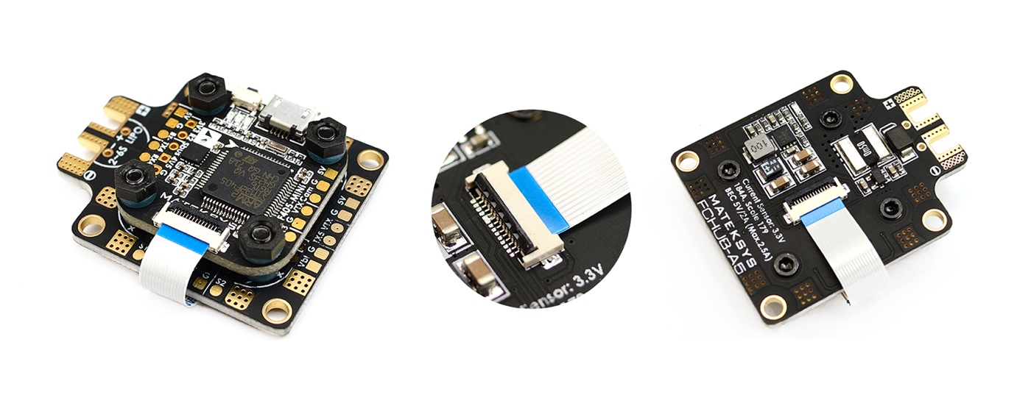
STAGES:
Version 1: Matek F405
Conduct research to reach an understanding of the drone aspects
Construction of indoor drone version 1 using Matek f405 mini
The Matek F405 was not “programming friendly”
The drone was controlled using a radio transmitter
ESC often broke down and need replacement
Incompatible telemetry pieces
ISSUES

Slide 11
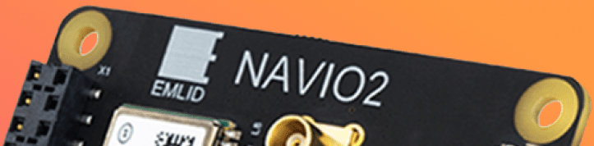






STAGES:
Version 2: ArduPilot

Slide 12


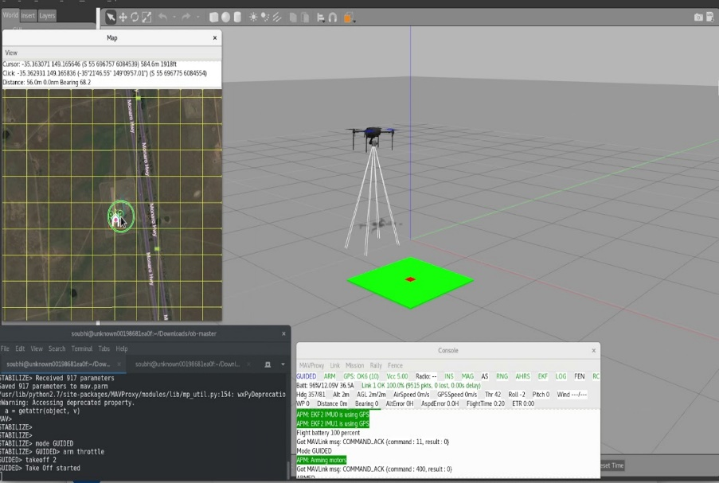


STAGES 2:
Achievements
Can communicate with a ground control station (GCS) using WIFI
Travel a predefined route in a room
Simulated flight (GPS and non-GPS) for SITL
3D simulated environment for SITL

Slide 13





STAGES 2:
ISSUES
Ground control commands sent but drone does not execute
Fail to bypass Non-GPS to execute scripts
Configuration errors
Unfinished calibration script

Slide 14
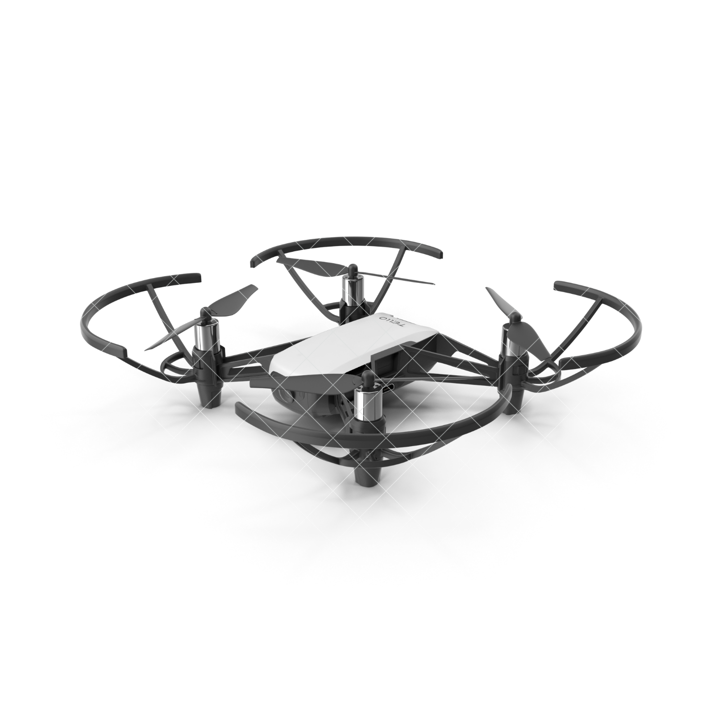




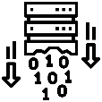

STAGES 3:
DJI Tello
Manual control drone through a web application
Follow object and keeping a safe distance (human face and a specific color)
Infrequent video streaming
Automated flight
Video data processing
Unfeasible environment will affect automated flight
ISSUES

Slide 15

ACHIEVEMENTS
Practice coding
Electronics handling
Drone concept and functional theory
Communication skill
Time management skills
Task management skills
Project management ability
Computer vision implementation
Data processing

Slide 16
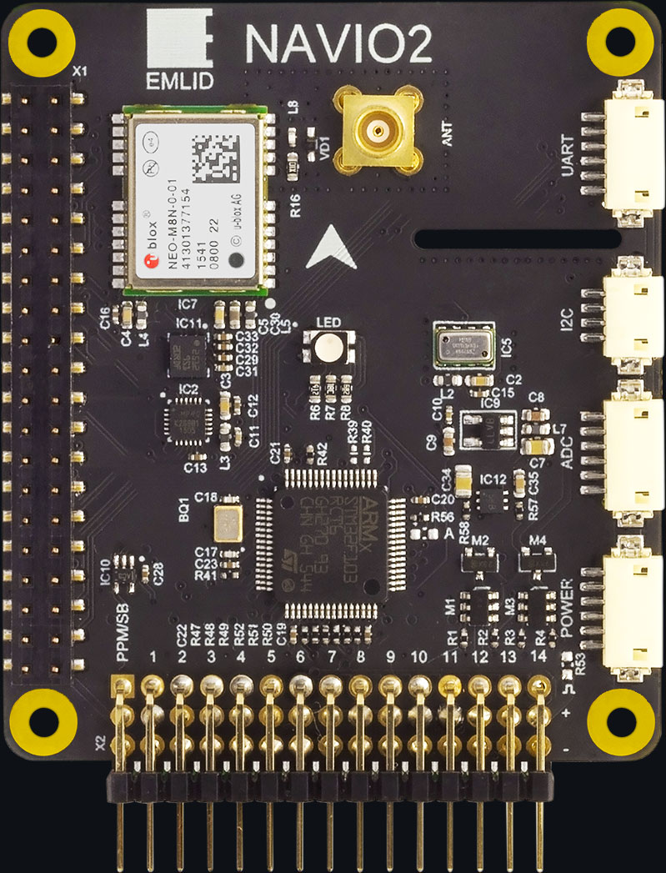
ACHIEVEMENT: HARDWARES
Drone operation concept
Create a hardware foundation to integrate Automation

Slide 17

ACHIEVEMENT: SOFTWARES
Customizable Visual controller
Communicating and process data from physical drone
Computer vision implementation
Automated flight

Slide 18
VIDS GOES HERE
ACHIEVEMENT: DEMOS

Slide 19
TOOLS

Slide 20

TARGET
AVERAGE SPEND PER CUSTOMER
MOST USED PLATFORMS
$27,00
55%
15-25
$32,00
15-25

